Slide 1
An Examination of the Scale of Evolution of Electric Vehicles
Somil Swapnil Chadra (22m0809)
Saurabh Kumar (22m0802)
Shashank Kate (2m0756)

Slide 2
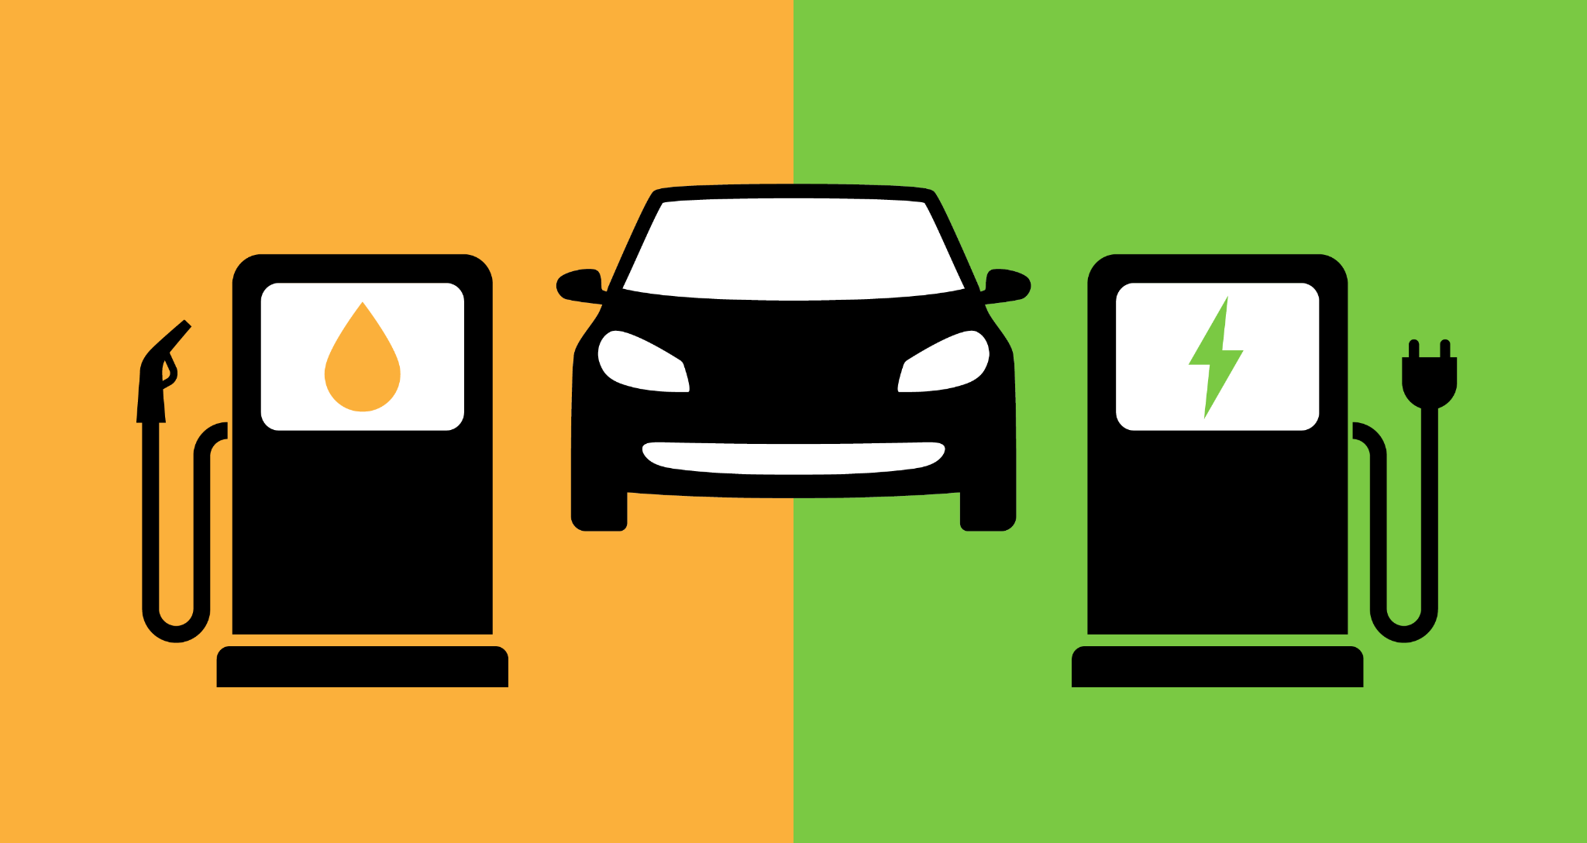
Problem Statement :
Electrification of transportation is gaining attention for low-pollution emissions and high fuel economy.
The adoption of EVs is facing several challenges:
High initial costs
Short range
Lack of charging infrastructure
Customer acceptance

Slide 3
Motivation behind the problem :
EVs promote environmentally friendly transportation
Scientific forecasting is vital for EV integration in transportation and electric power industries
EVs increase energy security by reducing dependence on oil prices and supply disruptions
EVs have higher initial costs but cheaper operating and maintenance costs than gas-powered vehicles
EVs have a significant economic impact and potential long-term benefits for the environment and energy security.

Slide 4
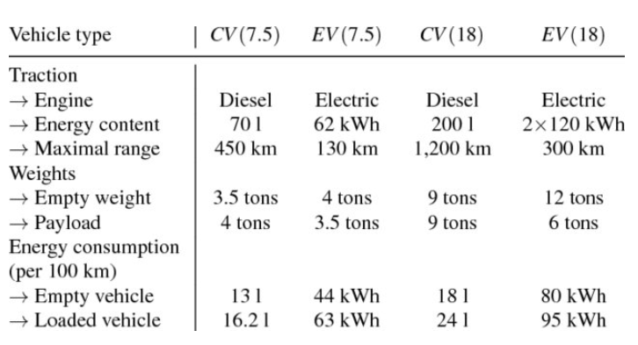
Literature Survey
Table : Characteristics of CVs and EVs
Fuel and mileage
Have effect on the scrape generated
Energy dynamics
Source : https://www.researchgate.net/publication/323259096_Energy_Vehicle_Routing_Problem_for_Differently_Sized_and_Powered_Vehicles/figures?lo=1

Slide 5
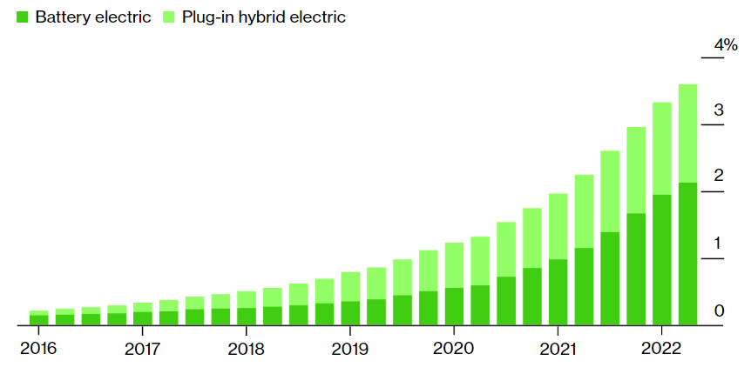
More than 3 percent vehicles are electric or hybrid
Source :https://www.bloomberg.com/graphics/2022-london-ulez-emissions-zone-electric-vehicles/#xj4y7vzkg

Slide 6
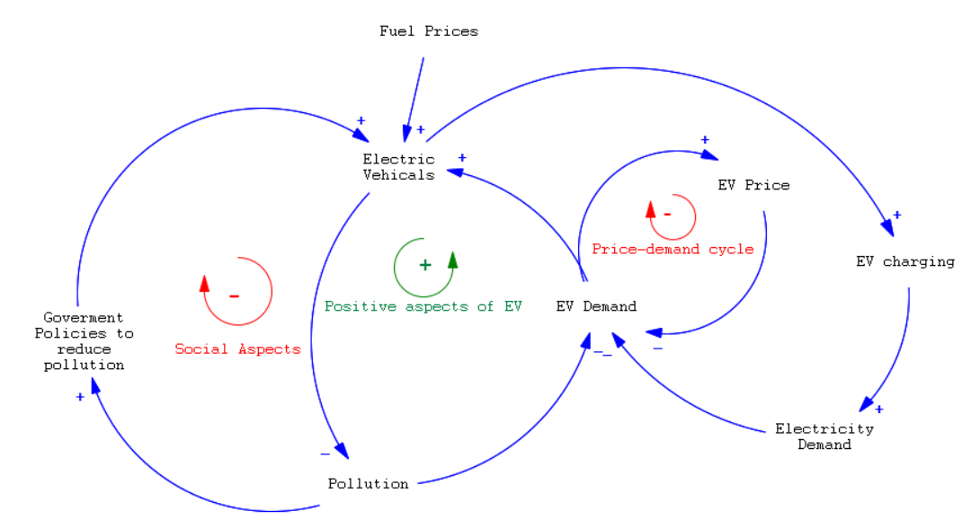
Main CLD :

Slide 7
Important Domains which are affected by EVs :
Environmental Domain
Financial Domain
Life of Individual

Slide 8
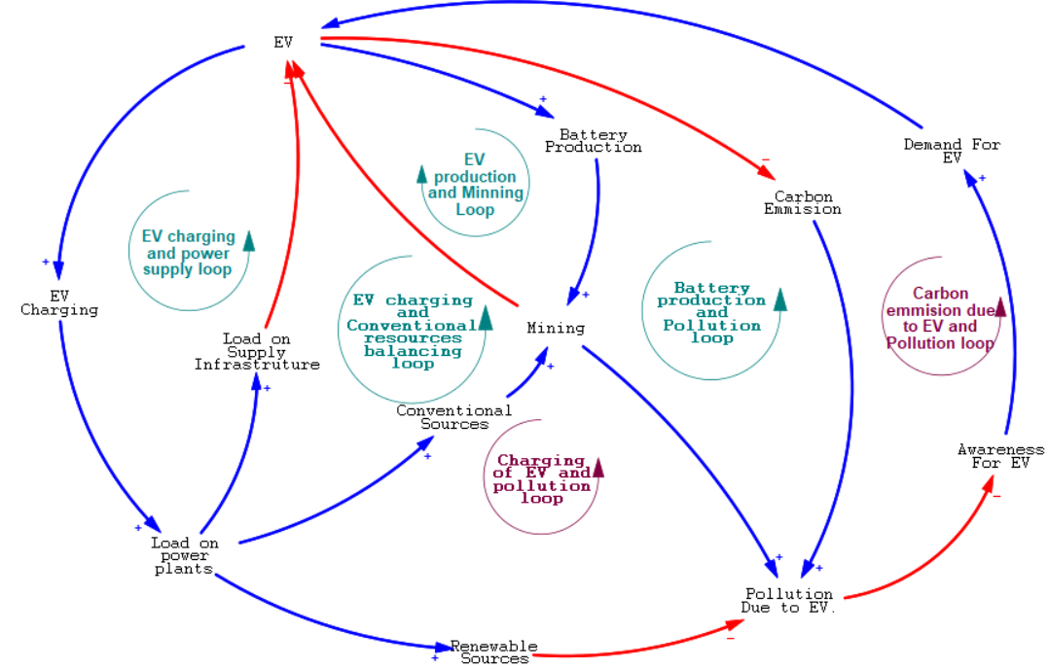
Environmental Aspects :
This shows what impact EVs have on our environment.
CLD representing the various effects of EV on Environment

Slide 9
Feedback Loops
EV charging and power supply loop: This is a balancing loop:
The loop shows how the increase in electric power demand will affect the EV market
Battery production and pollution loop: This is also a Balancing Loop:
As the mining of resources required to manufacture batteries for Ev result in environmental pollution, implying that manufacturing Ev increases the pollution, resulting in negative awareness for Ev.
Effect of EV’s carbon emission: This will form a Reinforcing Loop:
As the use of Ev increases the pollution will go down due to low carbon emission, resulting in increase in awareness of Ev for the general public, and demand of Ev.
As Ev increases the fuel engines go down, resulting in fall in pollution due to transport vehicles Hence more and more people will be attracted to use Ev and save their environment

Slide 10
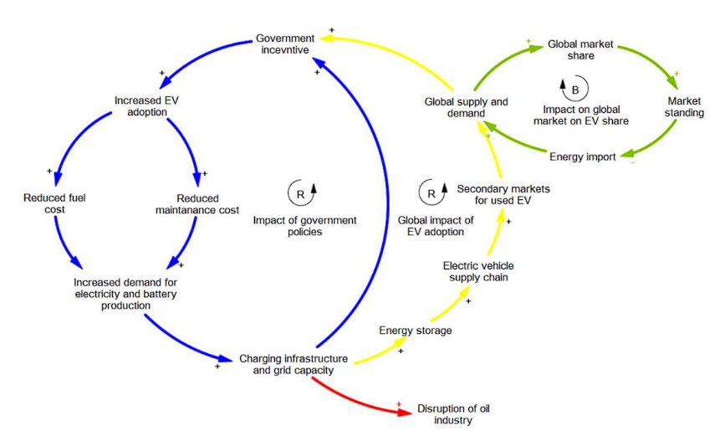
Financial Aspects :
This CLD depicts the financial and economic aspect of EV adoption on a nation.
CLD representing the interdependence of various financial factors in EV dynamics

Slide 11
Feedback Loops
Impact of government policies: This is a reinforcing loop:
As with the increased in incentives provided by government the sale of EV will increase which will also help in mitigating the pollution hazards.
Global Impact of EV adoption: This is also a reinforcing loop:
As the number of imports and exports of EV to the market from a nation will increase, more EV adoption incentives will be passed by the government to lure the customers.
Impact of global market on EV share: This will form a balancing loop:
As the global market supply and demand will increase the share of a nation in the global market will also increase which will eventually uplift its ranking.
Increased production of EV in a nation will result in less imports from other countries which in turn will decrease the global market share of the nation.

Slide 12
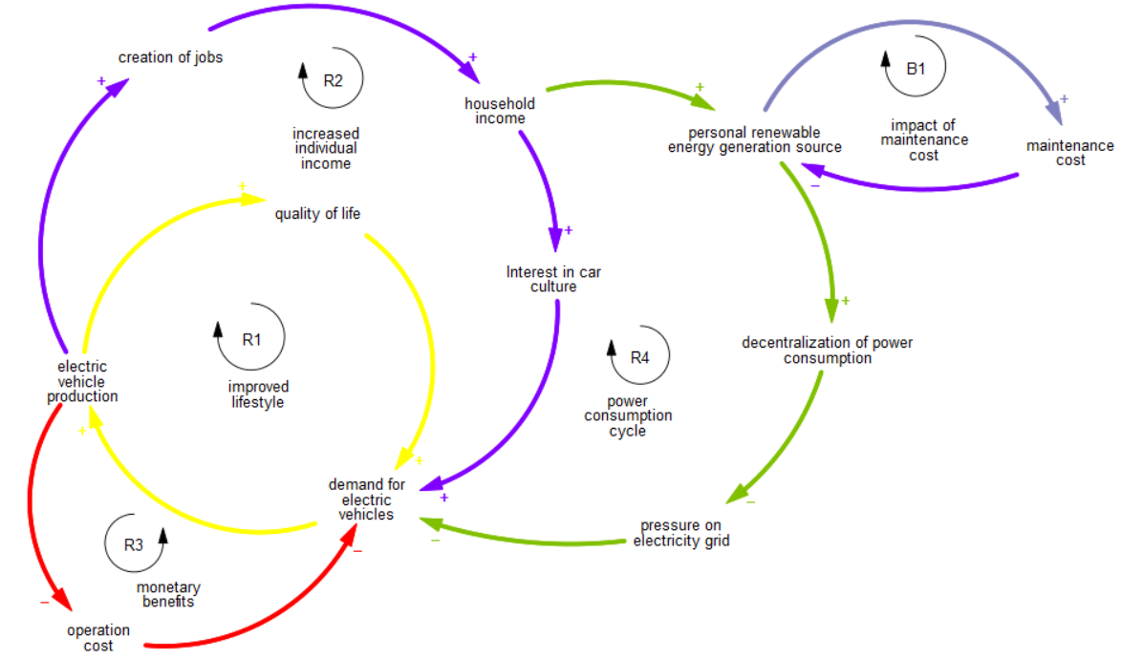
Aspects of an Individual’s life :
Here the impact of EV adoption is seen on an individuals life.
CLD representing interdependence of factors affecting an individual’s life

Slide 13
Feedback Loops
Increased individual income loop: It’s reinforcing loop. It basically describes how the EV production positively influences the household income which in turns adds to EV demand.
Power consumption cycle: It is also a reinforcing loop. It describes how more income can lead to less pressure on energy grid via investment in personal energy sources.
Impact of maintenance cost: It is a balancing loop. It says that people will invest less in personal energy sources because of their high maintenance costs.

Slide 14
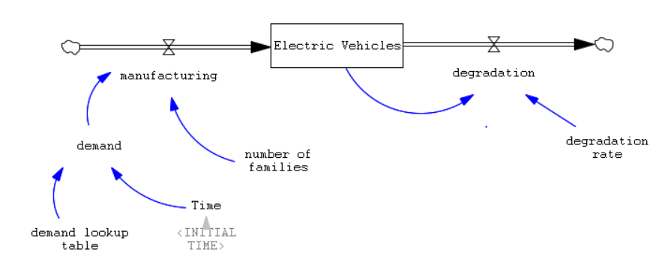
Initial SFD

Slide 15
Assumptions made
The manufacturing of EVs only depends upon the number of families in India and the demand for EVs.
Demand variable takes fractional values which are calculated from the previous 8 years of sales data of EVs
The number of years over the years remains constant.
.

Slide 16
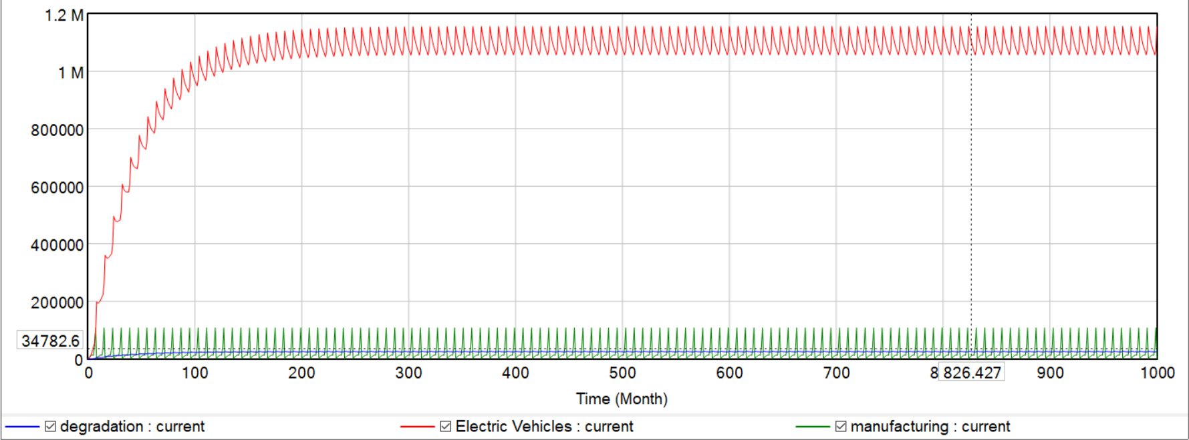
Initial SFD Graph
Number of EVs
Time (Year)

Slide 17
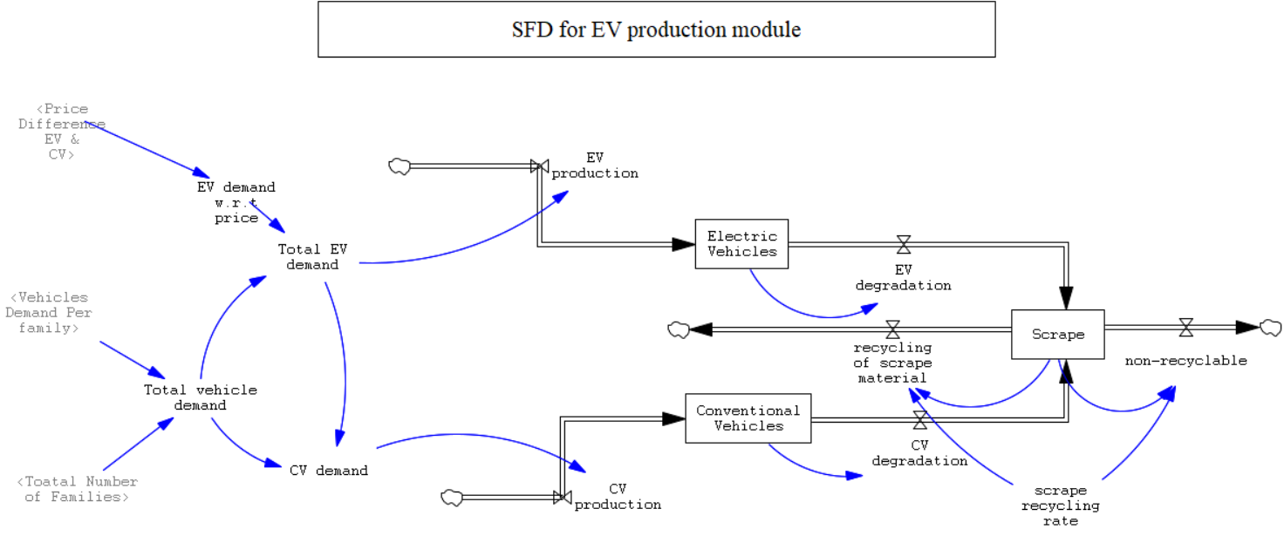
Modified SFD (EV Production Module)

Slide 18
Assumptions made
Raw materials are supplied at a constant rate, and production does not increase over time.
Raw materials used for both EV and CV are the same.
Degradation rates, recycling rate, and weights of EV and CV remain the same, and are assumed to be constant.
EV and CV define the number of vehicles of that class, on the road.
.

Slide 19
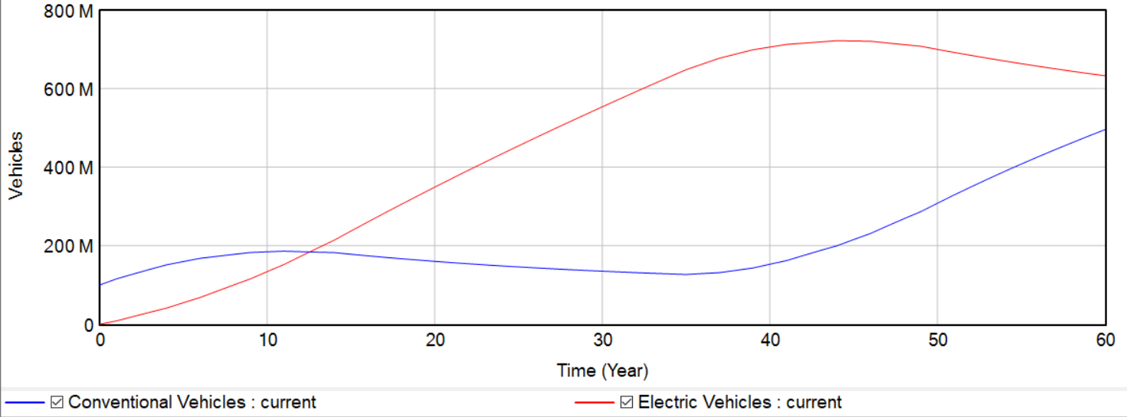
Modified SFD (EV Production Module):
Graphs
EV vs CV production graph

Slide 20
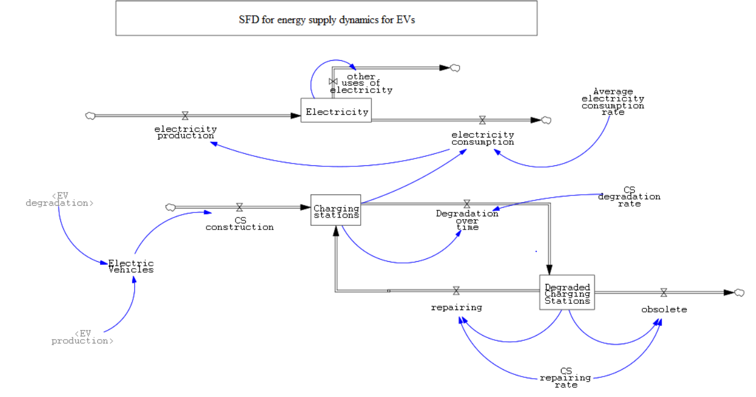
Modified SFD (Energy supply dynamics)

Slide 21
Assumptions made
Electricity consumption of other sources remains constant, w.r.t production i.e. 80% of total production.
The number of charging stations built is w.r.t. total EVs, and we build one charging station per 100 vehicles.
Both the degradation rate and repair rate of charging stations are constant at 10% and 70% respectively
.

Slide 22
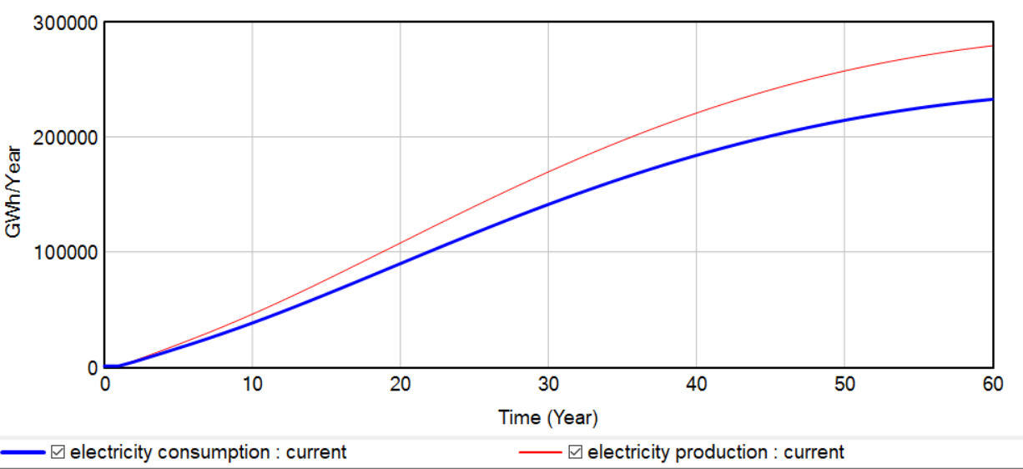
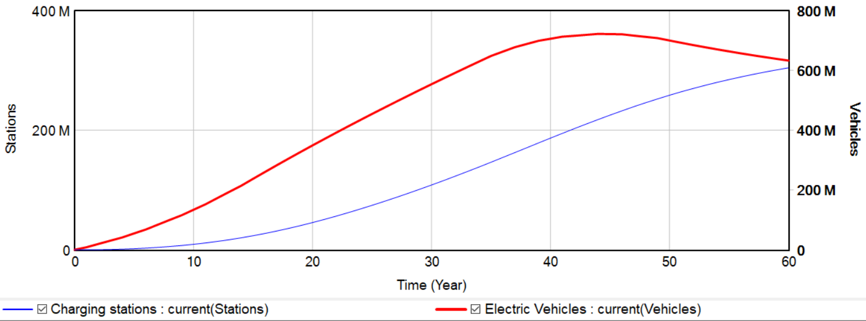
Modified SFD (Energy supply dynamics):
Graphs
Electricity production and consumption graph
Graph of number of charging stations w.r.t EV

Slide 23
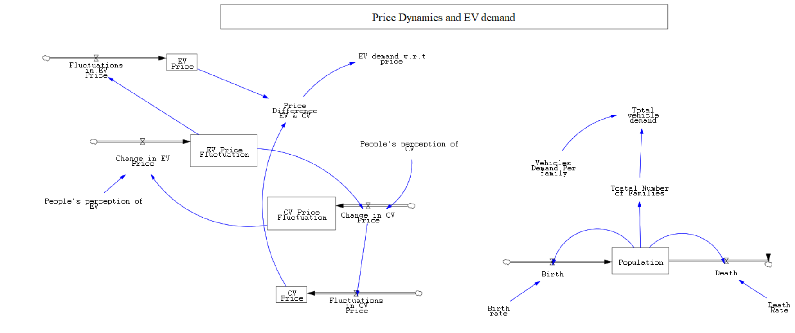
Modified SFD (Price dynamics)

Slide 24
Assumptions made
The price of EV and CV can increase by at most 10 % if the price of an EV last year.
The price of EV and CV are affected by lot of factors but considering only these two we introduce an repelling nature between the stock of EV and AV.
Modelling price dynamics was hard so we took the motivation to model it like Love Dynamics (“The Romeo - Juliet SFD Model”)

Slide 25
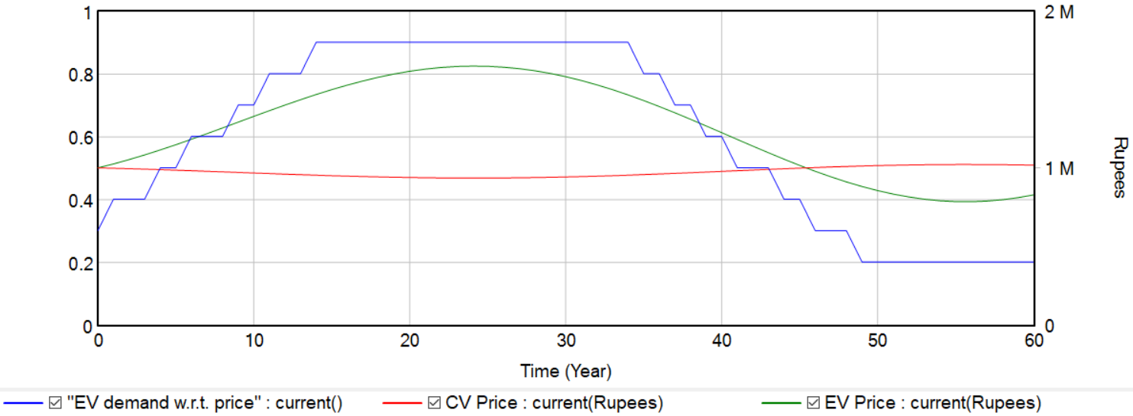
Modified SFD (Price dynamics):
Graph
Graph of EV demand, CV price and EV price

Slide 26
Analysis
Number of EV
Number of EVs will cross CV within a few decades
Price of EV
The price of EV will show constant fluctuation with an rising trend
Number
Price
Energy production and consumption will increase in a linear fashion
Energy dynamics
Number of charging stations will linearly grow and will start saturating
Charging stations
Energy
Stations

Slide 27
Challenges faced :
Identification of variables.
Finding the interdependency between the loop variables.
Developing a clear and comprehensive model for an individual was difficult.

Slide 28
Conclusion
Number of EV will surpass the number of CVs after a few decades.
Number of charging stations increases as the number of EV increases and starts saturating after a steep drop in the demand of EV.
As the demand of EV increases the price of EV also increases which starts dropping as the demand of EV decreases to retain the customers. The price of CV also keeps fluctuating( impacted by price of EV ).

